Slide 1
Fiscal Policy and Inclusive Growth
Claudiney Pereira, Arizona State University
Taller Igualdad y Erradicación de La Pobreza
FES-ILDIS
October 13, 2015

Slide 2
Presentation
  Introduction
  Inclusive Economic Growth
  Fiscal Policy and Inequality and Poverty Reduction
  Concluding Remarks

Slide 3
1. Introduction
Economic growth is not an end in itself
Conventional growth policies focus mostly on improving population’s income and consumption possibilities
Multidimensional nature of inequalities are often ignored
Limits to conventional policies

Slide 4
2. Inclusive Economic Growth
Addresses the multidimensional nature of inequalities
Standard monetary outcomes
Non-monetary outcomes: employment opportunities, job and life satisfaction, health, educational opportunities, environmental degradation (NOTE: it must include measurement)
Regional differences

Slide 5
2. Inclusive Economic Growth: Challenges for Developing Economies
Income gaps between rich and poor
Large young population entering the labor market Brazil’s “NEM-NEM” – 20% between 15-29 or 10 million
Inequality of opportunities: education, public goods services, finance
Regional differences
Ethnic groups
Economic and social policy choices must promote equity and growth objectives

Slide 6
3. Fiscal Policy and Inequality and Poverty
Commitment to Equity Institute (CEQ)
Led by Nora Lustig (Tulane University)
Launched in 2008
Goals:
  Generate input about effects of fiscal redistribution
  Provide a roadmap for governments, multilateral organizations, and nongovernmental organizations in their efforts to build more equitable societies

Slide 7
3. Fiscal Policy and Inequality and Poverty
Tulane University (2009-)
  Center for Inter-American Policy and Research
  School of Liberal Arts, Economics Department
  Stone Center for Latin American Studies
Bill & Melinda Gates Foundation
  CEQ Handbook (manual y software -- Master Workbook y paquete en Stata)
  CEQ Assessments en Ghana y Tanzania
Canadian International Development Agency (CIDA), Norwegian Ministry of Foreign Affairs, General Electric Foundation
Partnerships: CEPAL, CAF, World Bank, IDB, IFAD, and others.

Slide 8
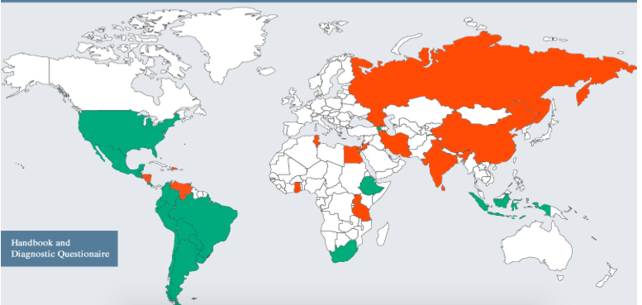
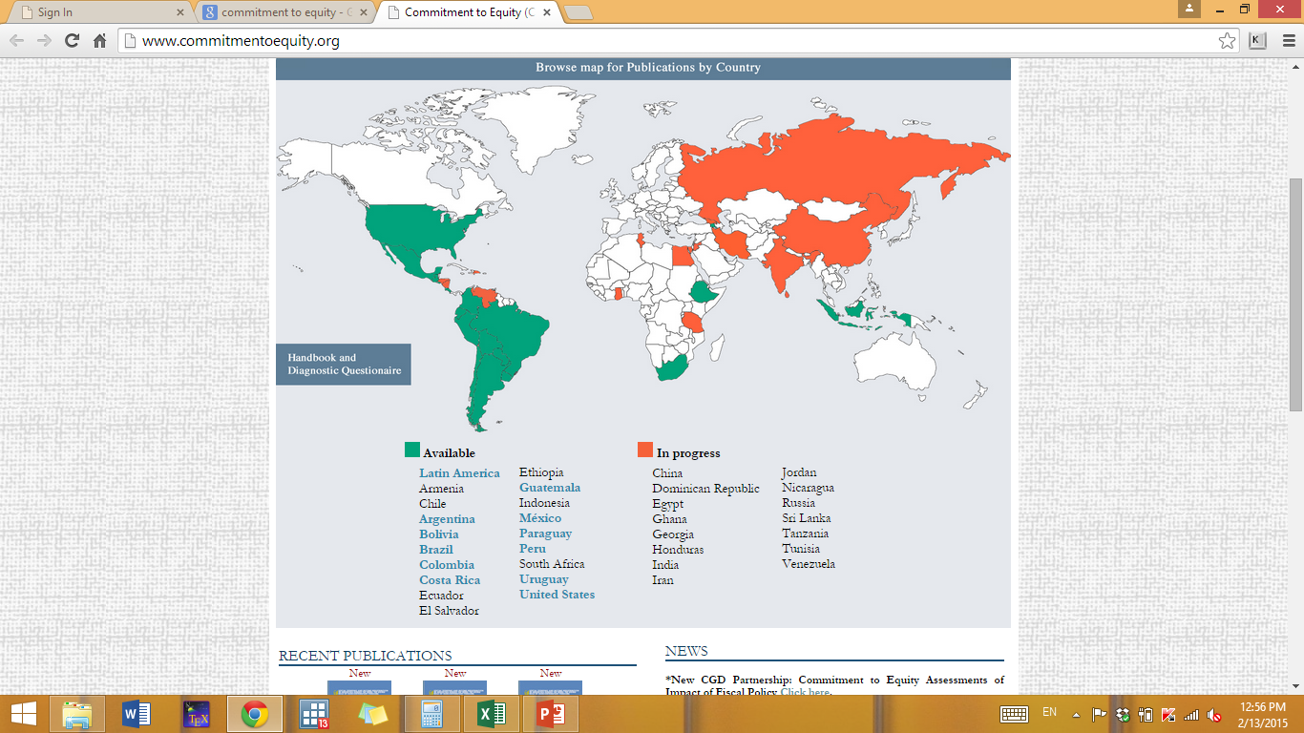
www.commitmenttoequity.org

Slide 9
3. Fiscal Policy and Inequality and Poverty
Assessment of current fiscal system:
What is the impact of taxes and government transfers on inequality and poverty?
Who are the net tax payers to the “fisc”?
How equitable is access to government education and/or health services? By income, gender, ethnic origin, for example.
How progressive are taxes and public spending?

Slide 10
3. Fiscal Policy and Inequality and Poverty
Impact of hypothetical or actual reforms:
How do inequality and poverty change when you eliminate VAT exemptions?
Who benefits from the elimination of user fees in primary education or the expansion of noncontributory pensions?
Who loses from the elimination of energy subsidies?

Slide 11
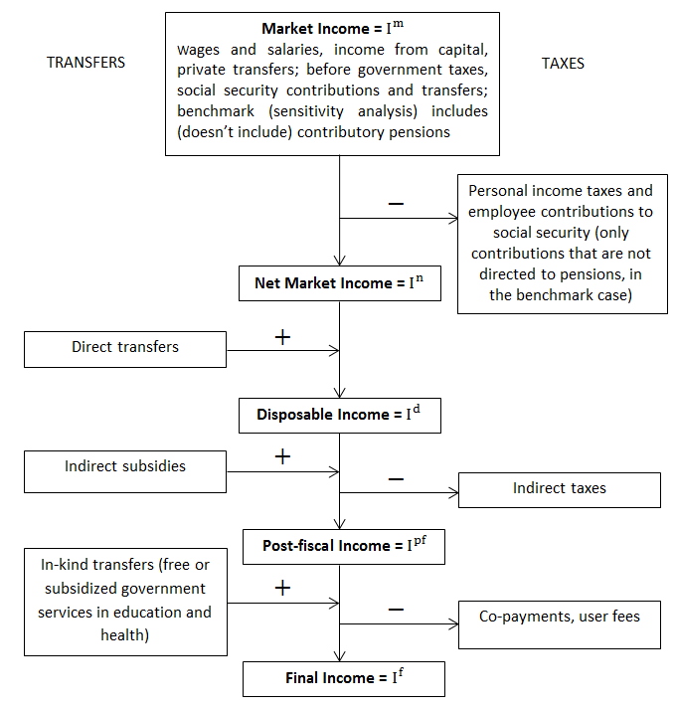

Slide 12
Conceptos de Ingreso
Ingreso de Mercado
+
Pensiones
Ingreso de Mercado más Pensiones
Transferencias Directas
+
-
Impuestos Directos
Ingreso no Sujeto a Impuestos
Ingreso Bruto
Ingreso de Mercado Neto
-
-
+
Impuestos Directos
Transferencias Directas
Ingreso Gravable
Ingreso Disponible
Subsidios Indirectos
+
-
Impuestos Indirectos
Ingreso Consumible
Transferencias en Especie (Educ, Salud)
+
-
Copagos, Tarifas de Usuario
Ingreso Final
Notes:
I added the third bullet point

Slide 13
3. Fiscal Policy and Inequality and Poverty
Comprehensive standard fiscal incidence analysis of current systems; no behavior and no general equilibrium effects
Harmonizes definitions and methodological approaches to facilitate cross-country comparisons
Uses income per capita as the welfare indicator
Allocators vary => full transparency in the method used for each category, tax shifting assumptions, etc.
Mainly average incidence; a few cases with marginal incidence
Incidence at the national level; rural and urban; by race and ethnicity

Slide 14
3. Fiscal Policy and Inequality and Poverty
Clarify and homogenize terminology: e.g., definitions of progressive or regressive taxes and transfers
Disaggregate changes in outcome indicators (disposable income inequality or poverty) into market and redistribution component
Development of new indicator: rate of impoverishment
  Fiscal Mobility Matrix (Higgins and Lustig, 2013)
  Extent to which poor (nonpoor) people who are made poorer (poor) by fiscal system

Slide 15
3. Fiscal Policy and Inequality and Poverty
Direct Taxes generally progressive but with little impact on inequality
CCTs progressive in absolute terms; well targeted in practically all countries
Indirect taxes regressive or neutral
Redistribution is larger through in-kind benefits in education and health than cash transfers

Slide 16
3. Fiscal Policy and Inequality and Poverty

Slide 17
3. Fiscal Policy and Inequality and Poverty
Diversity:
  government size: primary spending from 41 in Brazil to 19 percent of GDP in Peru
  extent of redistribution (25% in Arg, 7% in Peru)
Net payers to the fisc (in terms of cash) start at relatively low deciles
Tertiary Education is progressive in relative terms or neutral
Contributory Pensions are progressive (in relative terms) or regressive depending on the country

Slide 18
3. Fiscal Policy and Inequality and Poverty
Cash transfers reduce extreme poverty by more than 60 percent in Uruguay and Argentina…
….but only by 7 percent in Peru, which spends too little on cash transfers to achieve much poverty reduction
Notes:
Most important program in Argentina is the pension moratorium, a ‘one-time’ program only that will be phased-out as those born before the eligibility date die out

Slide 19
3. Fiscal Policy and Inequality and Poverty

Slide 20
3. Fiscal Policy and Inequality and Poverty

Slide 21
3. Fiscal Policy and Inequality and Poverty

Slide 22
3. Fiscal Policy and Inequality and Poverty
Argentina is among the most ‘effective’ countries at redistribution and poverty reduction; however, redistribution might have gone “too far”
Bolivia is a leftist government that redistributes little
Brazil
  indirect taxes wipe out cash transfers’ benefits to the poor and cause a significant amount of impoverishment
  the poor whites receive more in cash transfers than the poor black and pardos

Slide 23
3. Fiscal Policy and Inequality and Poverty
Mexico:
  Over time, redistribution has increased but Mexico still lags behind its peers such as Arg, Bra and Ury
  coverage of Oportunidades and other cash transfers leave about 30 percent of extreme poor without safety net
Peru: health spending is progressive only in relative terms
Uruguay: best among all six
  Reduces inequality and poverty among the highest
  Has among the highest effectiveness indicators
  All social spending categories are progressive in absolute terms
  Coverage of the poor is close to 100 percent
  Only evident problem: access to tertiary education is concentrated in the nonpoor

Slide 24
4. Concluding Remarks
Fiscal policy has a large effect reducing poverty and inequality
Design/redesign of fiscal systems are hard to implement
Fiscal sustainability (current crises)
Short-term and long-term effects and trade-offs

Slide 25
4. Concluding Remarks
Other studies
  Urban x Rural
  Gender
  Ethnic Groups
  Regional Inequalities
Inclusive Economic Growth policies: financial sector development (e.g. microcredit), educational coverage especially children, entrepreneurship, infrastructure, local governments.

Slide 26
Thank you
Gracias
Obrigado

Slide 27
References
Argentina: Lustig, Nora and Carola Pessino. Social Spending and Income Redistribution in Argentina in the 2000s: The Increasing Role of Noncontributory Pensions. In Lustig, Nora, Carola Pessino, and John Scott, editors, Fiscal Policy, Poverty and Redistribution in Latin America, Special Issue, Public Finance Review, May 2014.
Bolivia: Paz Arauco, Veronica, George Gray Molina, Wilson Jiménez Pozo, and Ernesto Yáñez Aguilar. Explaining Low Redistributive Impact in Bolivia. In Lustig, Nora, Carola Pessino, and John Scott, editors, Fiscal Policy, Poverty and Redistribution in Latin America, Special Issue, Public Finance Review, May 2014.
Brazil: Higgins, Sean and Claudiney Pereira. The Effects of Brazil’s Taxation and Social Spending on the Distribution of Household Income. In Lustig, Nora, Carola Pessino, and John Scott, editors, Fiscal Policy, Poverty and Redistribution in Latin America, Special Issue, Public Finance Review, May 2014.

Slide 28
References
Mexico: Scott, John. Redistributive Impact and Efficiency of Mexico’s Fiscal System. In Lustig, Nora, Carola Pessino, and John Scott, editors, Fiscal Policy, Poverty and Redistribution in Latin America, Special Issue, Public Finance Review, May 2014.
Peru: Jaramillo, Miguel. The Incidence of Social Spending and Taxes in Peru. In Lustig, Nora, Carola Pessino, and John Scott, editors, Fiscal Policy, Poverty and Redistribution in Latin America, Special Issue, Public Finance Review, May 2014.
Uruguay: Bucheli, Marisa, Nora Lustig, Máximo Rossi, and Florencia Amábile. Social Spending, Taxes, and Income Redistribution in Uruguay. In Lustig, Nora, Carola Pessino, and John Scott, editors, Fiscal Policy, Poverty and Redistribution in Latin America, Special Issue, Public Finance Review, May 2014.

