Slide 1





Extreme Poverty and Inequality: A Global Perspective
Claudiney Pereira, Arizona State University
Seminario Igualdad y Erradicación de La Pobreza
FES-ILDIS
FLACSO
October 12, 2015

Slide 2
Presentation
Introduction
  Poverty Measures
  Inequality Measures
Current Trends
Role of Fiscal Policy
  A) The Latin America Case
4) Concluding Remarks

Slide 3
1. Poverty and Inequality
UN Millenium Development Goals (MDGs), 1990. To reduce poverty by 50% in 2015
Sustainable Development Goals (SDGs), 2030
  UN: End poverty in all its forms everywhere
  World Bank: 3%

Slide 4
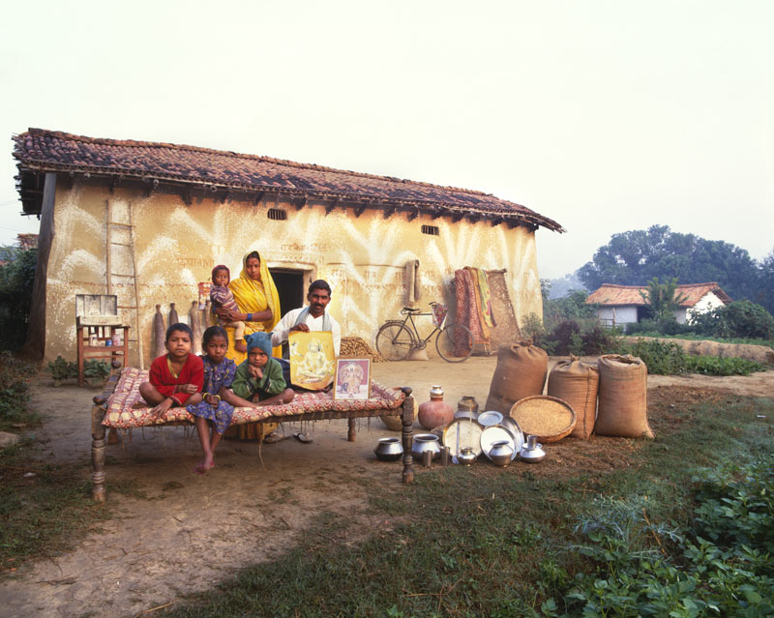
A typical Indian family with their possessions
Pictures by Peter Menzel and C. Mann, Material World. 1995.

Slide 5
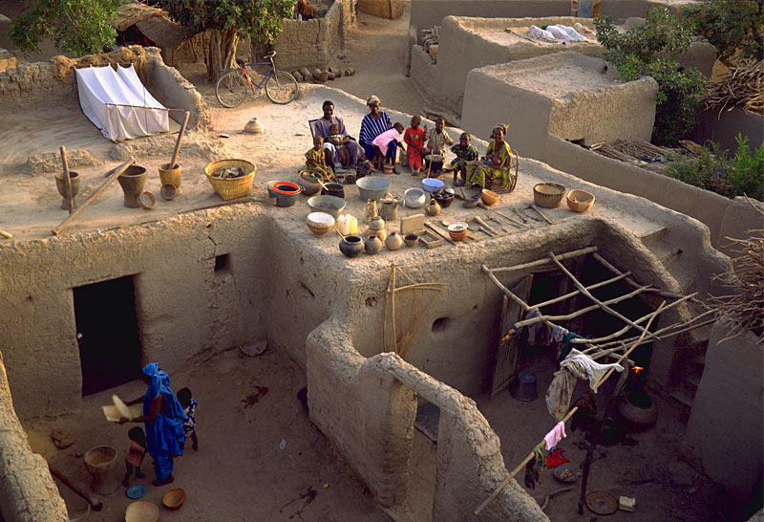
A typical Mali family with their possessions

Slide 6

A typical American family with their possessions
The Skeen Family, Houston.

Slide 7
Poverty Measures
Income measures
  Basic needs
  Comparative
Non-income measures
  Education
  Health
  Water and Sanitation
  Environmental damage
Multidimensional measures
Capability approach (Sen and others)

Slide 8
Poverty Measures
Poverty lines
    National
    International
Developing countries
Developed countries
  OECD: 60% of the median or mean income
  United States: a basket for a family of four (Department of Agriculture, $24,000 in 2014)

Slide 9
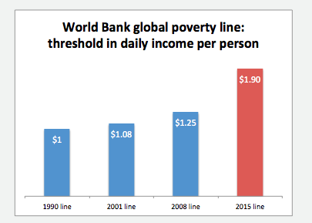
Poverty Measures
Source: Ferreira et al (2015),
Chart by Charles Kenny and Justin Sandefur

Slide 10
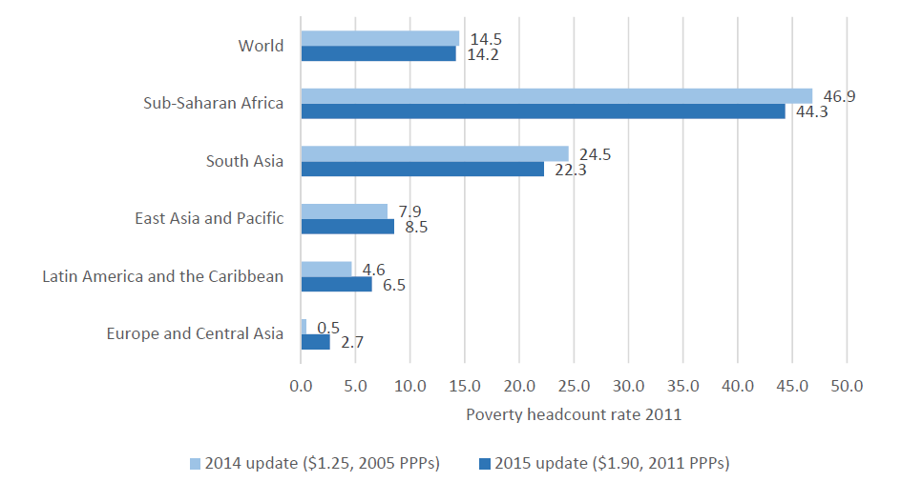
Poverty Measures
Source: Ferreira et al (2015)

Slide 11
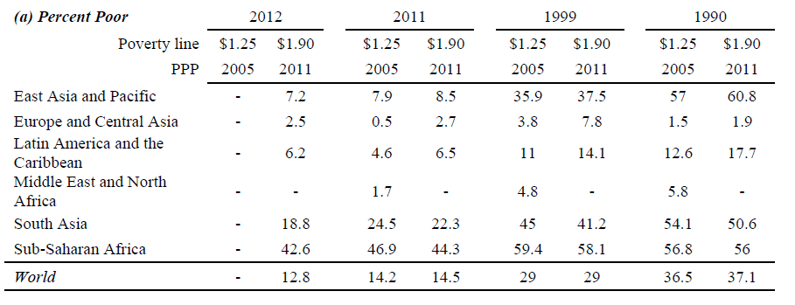
Poverty Measures
Source: Ferreira et al (2015)

Slide 12
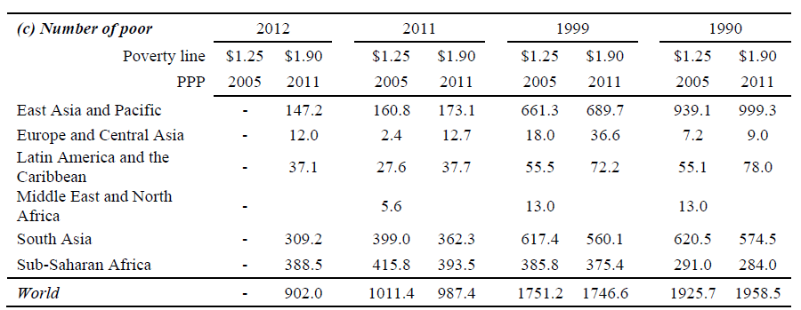
Poverty Measures
Source: Ferreira et al (2015)

Slide 13
Poverty Measures
    80% of the people living with less than US1.25/day reside in rural areas
    60% work in agriculture
    More women than men
    More than 1/3 of the people are under 13 years old

Slide 14
2. Current Trends
Source: Ferreira et al (2015)

Slide 15
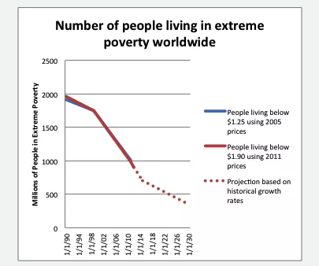
Current Trends
Source: Ferreira et al (2015),
Chart by Charles Kenny and Justin Sandefur

Slide 16
Inequality Measures
Gini Coefficient: between 0 and 1
  Perfect inequality:1
  Perfect equality:0
Multidimensional measures

Slide 17
3. Commitment to Equity (CEQ)
Led by Nora Lustig (Tulane University)
Launched in 2008
Goals:
  Generate input about effects of fiscal redistribution
  Provide a roadmap for governments, multilateral organizations, and nongovernmental organizations in their efforts to build more equitable societies

Slide 18
Funding
Tulane University (2009-)
  Center for Inter-American Policy and Research
  School of Liberal Arts, Economics Department
  Stone Center for Latin American Studies
Bill & Melinda Gates Foundation
  CEQ Handbook (manual y software -- Master Workbook y paquete en Stata)
  CEQ Assessments en Ghana y Tanzania
Canadian International Development Agency (CIDA), Norwegian Ministry of Foreign Affairs, General Electric Foundation

Slide 19
Partnerships
Banco Mundial
11 países, documentos, policy briefs, LAC Equity Lab
BID
10 países, por etnia y raza, documentos para LAC
ICEFI
4 países en Centroamérica, urbano/rural
IFAD
4 países, urbano/rural
CAF
Documento de trabajo
Economic Research Forum
Egypt y Iran
AfDB
Tunisia
CADEP
Paraguay
CBGA
India
FUSADES
El Salvador
REPOA
Tanzania
University of Ghana
Ghana
OCDE
Capítulo para publicación flagship y proyecto sobre redistribución y la clase media
FMI
Capítulo para volumen editado
ADB
Cuadro para publicación flagship; capítulo para volumen editado
UNDP
Ecuador (ingresos top) y Venezuela
CEPAL
Cuadro para publicación flagship
International Growth Center
Uganda

Slide 20
Coverage
33 countries
  Asia............................................................. 4
  Europe and Central Asia ….......................... 3
  Latin America and Caribbean (LAC)...............17
  Middle East and North Africa ………………… 4
  Sub-Saharan Africa…………………………………… 4
  United States
17 completed reports

Slide 21
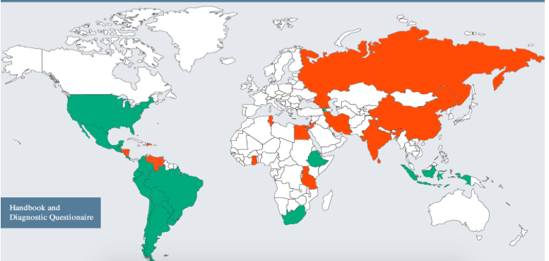
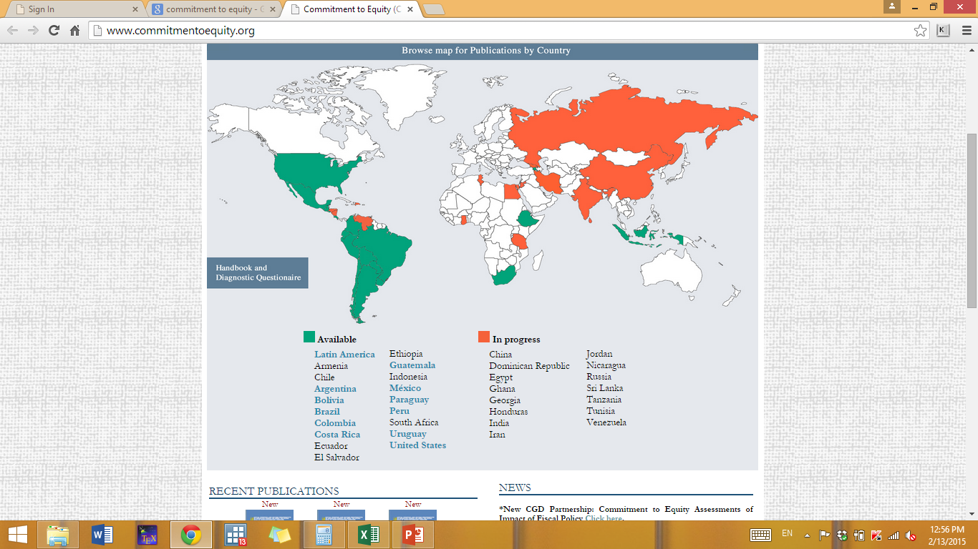
www.commitmenttoequity.org

Slide 22
Suppose you want to know…
Assessment of current fiscal system:
What is the impact of taxes and government transfers on inequality and poverty?
Who are the net tax payers to the “fisc”?
How equitable is access to government education and/or health services? By income, gender, ethnic origin, for example.
How progressive are taxes and public spending?

Slide 23
Suppose you want to know…
Impact of hypothetical or actual reforms:
How do inequality and poverty change when you eliminate VAT exemptions?
Who benefits from the elimination of user fees in primary education or the expansion of noncontributory pensions?
Who loses from the elimination of energy subsidies?

Slide 24
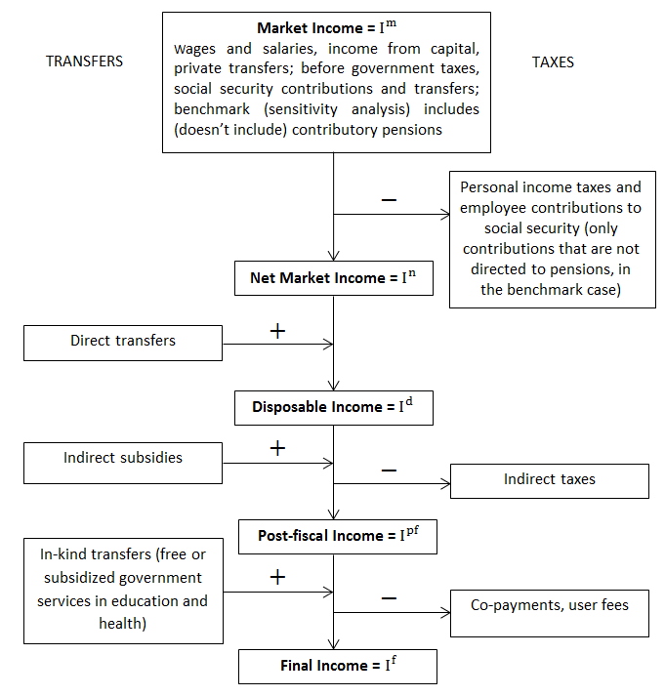

Slide 25
Conceptos de Ingreso
Ingreso de Mercado
+
Pensiones
Ingreso de Mercado más Pensiones
Transferencias Directas
+
-
Impuestos Directos
Ingreso no Sujeto a Impuestos
Ingreso Bruto
Ingreso de Mercado Neto
-
-
+
Impuestos Directos
Transferencias Directas
Ingreso Gravable
Ingreso Disponible
Subsidios Indirectos
+
-
Impuestos Indirectos
Ingreso Consumible
Transferencias en Especie (Educ, Salud)
+
-
Copagos, Tarifas de Usuario
Ingreso Final
Notes:
I added the third bullet point

Slide 26
Commitment to Equity Assessments (CEQ) for Latin America
Comprehensive standard fiscal incidence analysis of current systems; no behavior and no general equilibrium effects
Harmonizes definitions and methodological approaches to facilitate cross-country comparisons
Uses income per capita as the welfare indicator
Allocators vary => full transparency in the method used for each category, tax shifting assumptions, etc.
Mainly average incidence; a few cases with marginal incidence
Incidence at the national level; rural and urban; by race and ethnicity

Slide 27
Methodological Contributions
Clarify and homogenize terminology: e.g., definitions of progressive or regressive taxes and transfers
Disaggregate changes in outcome indicators (disposable income inequality or poverty) into market and redistribution component
Development of new indicator: rate of impoverishment

Slide 28
Rate of Impoverishment
Extent to which poor (nonpoor) people who are made poorer (poor) by fiscal system
Traditional indicators of poverty, inequality, stochastic dominance, horizontal inequity, progressivity fail to capture impoverishment
Proposed measures
Fiscal Mobility Matrix
  Impoverishment Headcount
  Impoverishment Gap
  See Higgins and Lustig (2013)

Slide 29
Main Results
Six countries published in Public Finance Review: Argentina, Bolivia, Brazil, Mexico, Peru and Uruguay
Seven countries finished recently: Chile, Colombia, Costa Rica, Ecuador, El Salvador, Guatemala, Paraguay
In progress: Dominican Republic, Honduras, Nicaragua, and Venezuela

Slide 30
Main Results: the Foreseeable
Direct Taxes generally progressive but with little impact on inequality
CCTs progressive in absolute terms; well targeted in practically all countries
Indirect taxes regressive or neutral
Redistribution is larger through in-kind benefits in education and health than cash transfers

Slide 31
Public spending on education and health is a more powerful equalizer than cash transfers

Slide 32
Ecuador (2011-2012)
Authors: Freddy Paúl Llerena Pinto, M. Cristhina Llerena Pinto, M. Andrea Llerena Pinto, Roberto Saá

Slide 33
Main Results: the Unexpected
Diversity:
  government size: primary spending from 41 in Brazil to 19 percent of GDP in Peru
  extent of redistribution (25% in Arg, 7% in Peru)
Net payers to the fisc (in terms of cash) start at relatively low deciles
Tertiary Education is progressive in relative terms or neutral
Contributory Pensions are progressive (in relative terms) or regressive depending on the country

Slide 34
Budget Size and Composition
Primary and Social Spending as % of GDP
Notes:
Size matters but is not destiny. Uruguay showed was number 2 in terms of redistribution and number 1 in terms of poverty reduction but its budget size is close to Mexico´s.
In Peru, fiscal space, however, may be a restriction.

Slide 35
Cash Transfers reduce poverty notably only when targeted and of significant magnitude
Cash transfers reduce extreme poverty by more than 60 percent in Uruguay and Argentina…
….but only by 7 percent in Peru, which spends too little on cash transfers to achieve much poverty reduction
Notes:
Most important program in Argentina is the pension moratorium, a ‘one-time’ program only that will be phased-out as those born before the eligibility date die out

Slide 36
Headcount: Before and After Cash Transfers

Slide 37
Fiscal Policy and Poverty
Headcount Ratio

Slide 38
Fiscal Policy and Poverty
Headcount Ratio(Ecuador)

Slide 39
However, indirect taxes wipe out the poverty-reducing effect of cash transfers

Slide 40
Net Payers to the Fisc

Slide 41
Main Results: the Unexpected
Argentina is among the most ‘effective’ countries at redistribution and poverty reduction; however, redistribution might have gone “too far”
Bolivia is a leftist government that redistributes little
Brazil
  indirect taxes wipe out cash transfers’ benefits to the poor and cause a significant amount of impoverishment
  the poor whites receive more in cash transfers than the poor black and pardos

Slide 42
Main Results: the Unexpected
Mexico:
  Over time, redistribution has increased but Mexico still lags behind its peers such as Arg, Bra and Ury
  coverage of Oportunidades and other cash transfers leave about 30 percent of extreme poor without safety net
Peru: health spending is progressive only in relative terms

Slide 43
“Poster-child:” Uruguay
Primary Spending/GDP is within reasonable levels
Reduces inequality and poverty among the highest
Has among the highest effectiveness indicators
Taxes are neutral
All social spending categories are progressive in absolute terms
Coverage of the poor is close to 100 percent
Only evident problem: access to tertiary education is concentrated in the nonpoor

Slide 44
Concluding Remarks
Direct taxes and cash transfers reduce inequality and poverty by nontrivial amounts in Argentina, Brazil, and Uruguay but less so in Bolivia, Mexico, and Peru
Direct taxes are progressive, but redistributive impact is small
Cash transfers programs are quite progressive in absolute terms, except in Bolivia
In Bolivia and Brazil, indirect taxes more than offset the poverty reducing impact of cash transfers
In-kind benefits have a large effect on reducing inequality in all countries

Slide 45
Concluding Remarks
Other studies
  Urban x Rural
  Gender
  Ethnic Groups
  Regional differences
“We shall soon with the help of God be within sight of the day when poverty will be banished from the nation.”
Joao Ubaldo Ribeiro (Brazilian writer)

Slide 46
Thank you
Gracias
Obrigado

Slide 47
References
Argentina: Lustig, Nora and Carola Pessino. Social Spending and Income Redistribution in Argentina in the 2000s: The Increasing Role of Noncontributory Pensions. In Lustig, Nora, Carola Pessino, and John Scott, editors, Fiscal Policy, Poverty and Redistribution in Latin America, Special Issue, Public Finance Review, May 2014.
Bolivia: Paz Arauco, Veronica, George Gray Molina, Wilson Jiménez Pozo, and Ernesto Yáñez Aguilar. Explaining Low Redistributive Impact in Bolivia. In Lustig, Nora, Carola Pessino, and John Scott, editors, Fiscal Policy, Poverty and Redistribution in Latin America, Special Issue, Public Finance Review, May 2014.
Brazil: Higgins, Sean and Claudiney Pereira. The Effects of Brazil’s Taxation and Social Spending on the Distribution of Household Income. In Lustig, Nora, Carola Pessino, and John Scott, editors, Fiscal Policy, Poverty and Redistribution in Latin America, Special Issue, Public Finance Review, May 2014.

Slide 48
References
Mexico: Scott, John. Redistributive Impact and Efficiency of Mexico’s Fiscal System. In Lustig, Nora, Carola Pessino, and John Scott, editors, Fiscal Policy, Poverty and Redistribution in Latin America, Special Issue, Public Finance Review, May 2014.
Peru: Jaramillo, Miguel. The Incidence of Social Spending and Taxes in Peru. In Lustig, Nora, Carola Pessino, and John Scott, editors, Fiscal Policy, Poverty and Redistribution in Latin America, Special Issue, Public Finance Review, May 2014.
Uruguay: Bucheli, Marisa, Nora Lustig, Máximo Rossi, and Florencia Amábile. Social Spending, Taxes, and Income Redistribution in Uruguay. In Lustig, Nora, Carola Pessino, and John Scott, editors, Fiscal Policy, Poverty and Redistribution in Latin America, Special Issue, Public Finance Review, May 2014.
Ecuador: Pinto, Freddy P.L., M. C. L. Pinto, M.A.L. Pinto, R. Saá. Social Spending, Taxes and Income Redistribution in Ecuador. CEQ, Working Paper no. 28, February 2015.
Ferreira, F.H.G. et al. A Global Count of the Extreme Poor in 2002: Data Issues, Methodology and Initial Results. World Bank, WPS 7432, October 2015.

