Slide 1





The Impact of Taxes and Social Spending on Inequality and Poverty in Argentina, Bolivia, Brazil, Mexico, Peru and Uruguay:
An Overview
Claudiney Pereira, Tulane University
Public Finance Workshop
ECLAC, United Nations
Santiago, Chile
January 22, 2014

Slide 2
Suppose you want to know…
Assessment of current fiscal system:
What is the impact of taxes and government transfers on inequality and poverty?
Who are the net tax payers to the “fisc”?
How equitable is access to government education and/or health services? By income, gender, ethnic origin, for example.
How progressive are taxes and public spending?

Slide 3
Suppose you want to know…
Impact of hypothetical or actual reforms:
How do inequality and poverty change when you eliminate VAT exemptions?
Who benefits from the elimination of user fees in primary education or the expansion of noncontributory pensions?
Who loses from the elimination of energy subsidies?

Slide 4
Basic elements of standard fiscal incidence
Start with:
Before taxes income of unit h, or I_{h}
Taxes T_{i}
“Allocators” of tax i to unit h, or S_{ih} (or the share of tax i borne by unit h)
Then, post-tax income of unit h (Y_{h}) is:
Y_{h} = I_{h} - ∑_{i} T_{i}S_{ih}

Slide 5
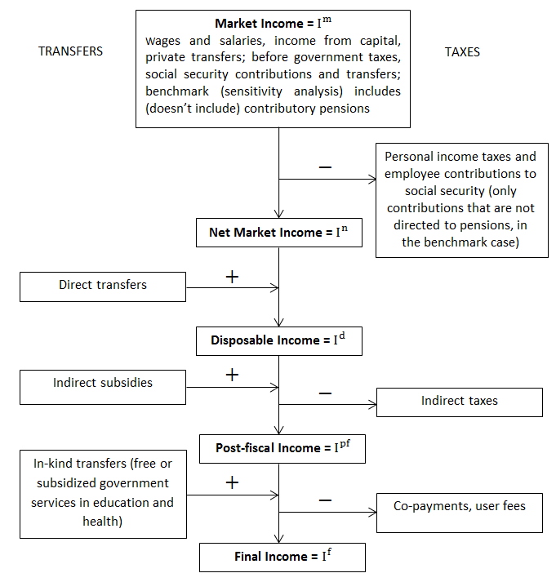

Slide 6
Allocation Methods
Direct Identification in microdata
If not in microdata, then:
  Simulation
  Imputation
  Inference
  Alternate Survey
  Secondary Sources

Slide 7
Allocation Methods
Tax shifting assumptions
Tax evasion assumptions
Take-up of cash transfers programs
Monetizing in-kind transfers

Slide 8
Commitment to Equity Assessments (CEQ) for Latin America
Comprehensive standard fiscal incidence analysis of current systems; no behavior and no general equilibrium effects
Harmonizes definitions and methodological approaches to facilitate cross-country comparisons
Uses income per capita as the welfare indicator
Allocators vary => full transparency in the method used for each category, tax shifting assumptions, etc.
Mainly average incidence; a few cases with marginal incidence
Incidence at the national level; rural and urban; by race and ethnicity

Slide 9
Methodological Contributions
Clarify and homogenize terminology: e.g., definitions of progressive or regressive taxes and transfers
Disaggregate changes in outcome indicators (disposable income inequality or poverty) into market and redistribution component
Development of new indicator: rate of impoverishment

Slide 10
Rate of Impoverishment
Extent to which poor (nonpoor) people who are made poorer (poor) by fiscal system
Traditional indicators of poverty, inequality, stochastic dominance, horizontal inequity, progressivity fail to capture impoverishment
Proposed measures
Fiscal Mobility Matrix
  Impoverishment Headcount
  Impoverishment Gap
  See Higgins and Lustig (2013)

Slide 11
Main Results
Six countries publication in progress in Public Finance Review: Argentina, Bolivia, Brazil, Mexico, Peru and Uruguay
Six countries finished recently: Chile, Colombia, Costa Rica, El Salvador, Guatemala, Paraguay
In progress: Ecuador, Dominican Republic(*), Honduras, Nicaragua, and Venezuela

Slide 12
Main Results: the Foreseeable
Direct Taxes generally progressive but with little impact on inequality
CCTs progressive in absolute terms; well targeted in practically all countries
Indirect taxes regressive or neutral
Redistribution is larger through in-kind benefits in education and health than cash transfers

Slide 13
Progressivity of Taxes & Transfers
 |  |  | Argentina | Bolivia | Brazil | Mexico | Peru | Uruguay
Gini Market Income |  |  | 0.49* | 0.50 | 0.58 | 0.51 | 0.50 | 0.49
Kakwani Coefficient | Ta x e s | Direct Taxes | na | ne | 0.19 | 0.30 | 0.43 | 0.25
 |  | Indirect Taxes | na | -0.13 | -0.06 | 0.01 | 0.02 | -0.05
 |  | All | na | -0.13 | 0.02 | 0.11 | 0.08 | 0.07
Concentration Coefficients | Di r e c t Tr a n s f e r s | Noncontributory Pensions | -0.27 | 0.01 | -0.48 | -0.10 | ne | -0.53
 |  | Flagship CCTsa | -0.50 | -0.25 | -0.58 | -0.54 | -0.65 | -0.61
 |  | All | -0.31 | -0.07 | 0.03 | -0.30 | -0.48 | -0.47
 | Ed u c a t i o n Sp e n d i n g | Pre-school | na | -0.21 | -0.33 | -0.24 | -0.25 | -0.45
 |  | Primary | -0.39 | -0.25 | -0.31 | -0.25 | -0.34 | -0.43
 |  | Secondary | -0.24 | -0.12 | -0.21 | -0.08 | -0.20 | -0.12
 |  | Tertiary | 0.20 | 0.30 | 0.44 | 0.32 | 0.31 | 0.47
 |  | All | -0.20 | -0.02 | -0.15 | -0.09 | -0.17 | -0.11
 | He a l t h S p e n d i n g |  | -0.23 | -0.04 | -0.11 | 0.04 | 0.18 | -0.10
 | So c i a l Sp e n d i n g |  | -0.15 | -0.04 | -0.09 | -0.06 | -0.02 | -0.16
 | In d i re c t S u b s id ie s |  | 0.29 | 0.37 | -0.27 | 0.26 | na | ne
 | To t a l B e n e f i t s |  | -0.05 | -0.02 | -0.09 | -0.02 | -0.02 | -0.16

Slide 14
Public spending on education and health is a more powerful equalizer than cash transfers

Slide 15
Main Results: the Unexpected
Diversity:
  government size: primary spending from 41 in Brazil to 19 percent of GDP in Peru
  extent of redistribution (25% in Arg, 7% in Peru)
Net payers to the fisc (in terms of cash) start at relatively low deciles
Tertiary Education is progressive in relative terms or neutral
Contributory Pensions are progressive (in relative terms) or regressive depending on the country

Slide 16
Budget Size and Composition
Primary and Social Spending as % of GDP
Notes:
Size matters but is not destiny. Uruguay showed was number 2 in terms of redistribution and number 1 in terms of poverty reduction but its budget size is close to Mexico´s.
In Peru, fiscal space, however, may be a restriction.

Slide 17
Cash Transfers reduce poverty notably only when targeted and of significant magnitude
Cash transfers reduce extreme poverty by more than 60 percent in Uruguay and Argentina…
….but only by 7 percent in Peru, which spends too little on cash transfers to achieve much poverty reduction
Notes:
Most important program in Argentina is the pension moratorium, a ‘one-time’ program only that will be phased-out as those born before the eligibility date die out

Slide 18
Headcount: Before and After Cash Transfers

Slide 19
Fiscal Policy and Poverty
Headcount Ratio

Slide 20
However, indirect taxes wipe out the poverty-reducing effect of cash transfers

Slide 21
Net Payers to the Fisc

Slide 22
Main Results: the Unexpected
Argentina is among the most ‘effective’ countries at redistribution and poverty reduction; however, redistribution might have gone “too far”
Bolivia is a leftist government that redistributes little
Brazil
  indirect taxes wipe out cash transfers’ benefits to the poor and cause a significant amount of impoverishment
  the poor whites receive more in cash transfers than the poor black and pardos

Slide 23
Main Results: the Unexpected
Mexico:
  Over time, redistribution has increased but Mexico still lags behind its peers such as Arg, Bra and Ury
  coverage of Oportunidades and other cash transfers leave about 30 percent of extreme poor without safety net
Peru: health spending is progressive only in relative terms

Slide 24
“Poster-child:” Uruguay
Primary Spending/GDP is within reasonable levels
Reduces inequality and poverty among the highest
Has among the highest effectiveness indicators
Taxes are neutral
All social spending categories are progressive in absolute terms
Coverage of the poor is close to 100 percent
Only evident problem: access to tertiary is concentrated in the nonpoor

Slide 25
Conclusions
Direct taxes and cash transfers reduce inequality and poverty by nontrivial amounts in Argentina, Brazil, and Uruguay but less so in Bolivia, Mexico, and Peru
Direct taxes are progressive, but redistributive impact is small
Cash transfers programs are quite progressive in absolute terms, except in Bolivia
In Bolivia and Brazil, indirect taxes more than offset the poverty reducing impact of cash transfers
In-kind benefits have a large effect on reducing inequality in all countries

Slide 26
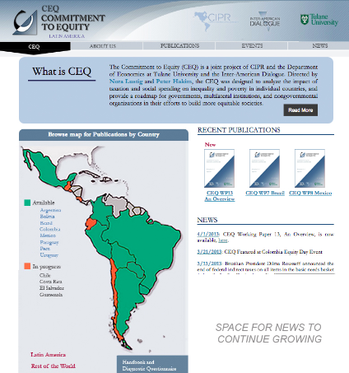
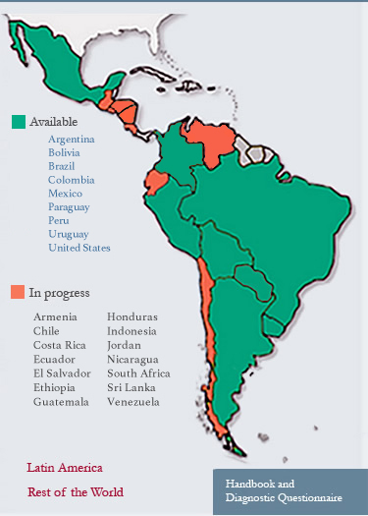
Commitment to Equity (CEQ), joint project of Tulane University and Inter-American Dialogue. www.commitmentoequity.org

Slide 27
CEQ Global
World Bank
Armenia
Ethiopia
Indonesia
Jordan
South Africa
Sri Lanka
Gates Foundation
Ghana
Tanzania

Slide 28
Acknowledgements
This paper was produced under the Commitment to Equity (CEQ) project.
Launched in 2008, the CEQ framework was designed to analyze the impact of taxation and social spending on inequality and poverty in individual countries and to provide a roadmap for governments, multilateral institutions, and nongovernmental organizations in their efforts to build more equitable societies.
Led by Nora Lustig and Peter Hakim, the CEQ is a project of the Center for Inter-American Policy and the Department of Economics, Tulane University and the Inter-American Dialogue.
Since its inception, the CEQ has received financial support from Tulane University's Center for Inter-American Policy and Research, the School of Liberal Arts and the Stone Center for Latin American Studies as well as the Canadian International Development Agency (CIDA), the Development Bank of Latin America (CAF), the General Electric Foundation, the Inter-American Development Bank (IADB), the International Fund for Agricultural Development (IFAD), the Norwegian Ministry of Foreign Affairs, the United Nations Development Programme's Regional Bureau for Latin America and the Caribbean (UNDP/RBLAC), and the World Bank.

Slide 29
Thank you!

Slide 30
References
Argentina: Lustig, Nora and Carola Pessino. Social Spending and Income Redistribution in Argentina in the 2000s: The Rising Role of Noncontributory Pensions. In Lustig, Nora, Carola Pessino, and John Scott, editors, Fiscal Policy, Poverty and Redistribution in Latin America, Special Issue, Public Finance Review, forthcoming.
Bolivia: Paz Arauco, Veronica, George Gray Molina, Wilson Jiménez Pozo, and Ernesto Yáñez Aguilar. Explaining Low Redistributive Impact in Bolivia. In Lustig, Nora, Carola Pessino, and John Scott, editors, Fiscal Policy, Poverty and Redistribution in Latin America, Special Issue, Public Finance Review, forthcoming.
Brazil: Higgins, Sean and Claudiney Pereira. The Effects of Brazil’s High Taxation and Social Spending on the Distribution of Household Income. In Lustig, Nora, Carola Pessino, and John Scott, editors, Fiscal Policy, Poverty and Redistribution in Latin America, Special Issue, Public Finance Review, forthcoming.

Slide 31
References
Mexico: Scott, John. Redistributive Impact and Efficiency of Mexico’s Fiscal System. In Lustig, Nora, Carola Pessino, and John Scott, editors, Fiscal Policy, Poverty and Redistribution in Latin America, Special Issue, Public Finance Review, forthcoming.
Peru: Jaramillo, Miguel. The Incidence of Social Spending and Taxes in Peru. In Lustig, Nora, Carola Pessino, and John Scott, editors, Fiscal Policy, Poverty and Redistribution in Latin America, Special Issue, Public Finance Review, forthcoming.
Uruguay: Bucheli, Marisa, Nora Lustig, Máximo Rossi, and Florencia Amábile. Social Spending, Taxes, and Income Redistribution in Uruguay. In Lustig, Nora, Carola Pessino, and John Scott, editors, Fiscal Policy, Poverty and Redistribution in Latin America, Special Issue, Public Finance Review, forthcoming.

