Slide 1
The Effects of Brazil’s High Taxation and Social Spending on the Distribution of Household Income
Sean Higgins and Claudiney Pereira
Department of Economics
Tulane University
LASA 2013, Washington, DC
May 31, 2013

Slide 2
Introduction
Inequality and poverty in Brazil
Other studies
  Immervoll et al. (2009)
  Nogueira et al. (2011)
  Silveira et al. (2011)
  Souza and Souza (2012)
Our contribution:
  Most comprehensive study to date:
    Transfers
    Subsidies
    Indirect
  Comparable methodology (CEQ)

Slide 3
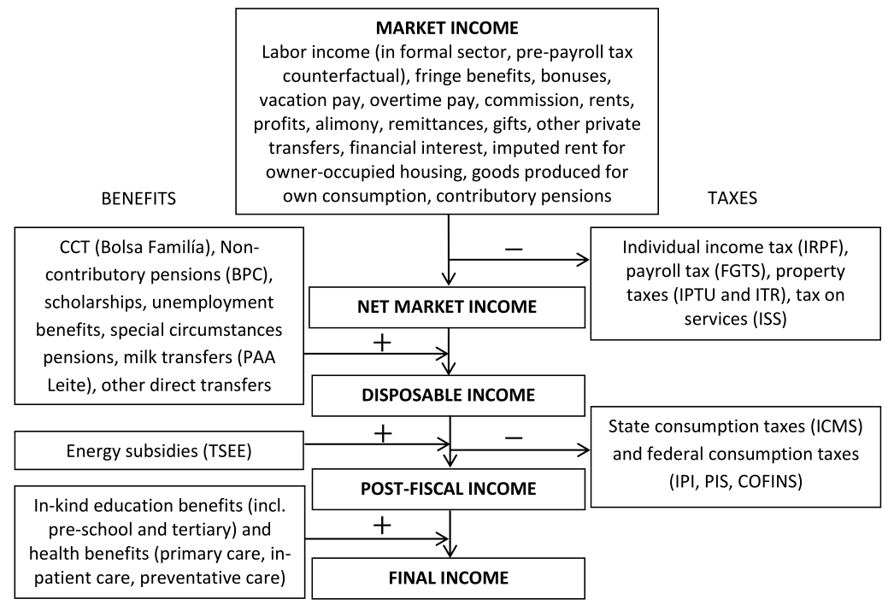
Definition of income concepts: Benchmark case

Slide 4
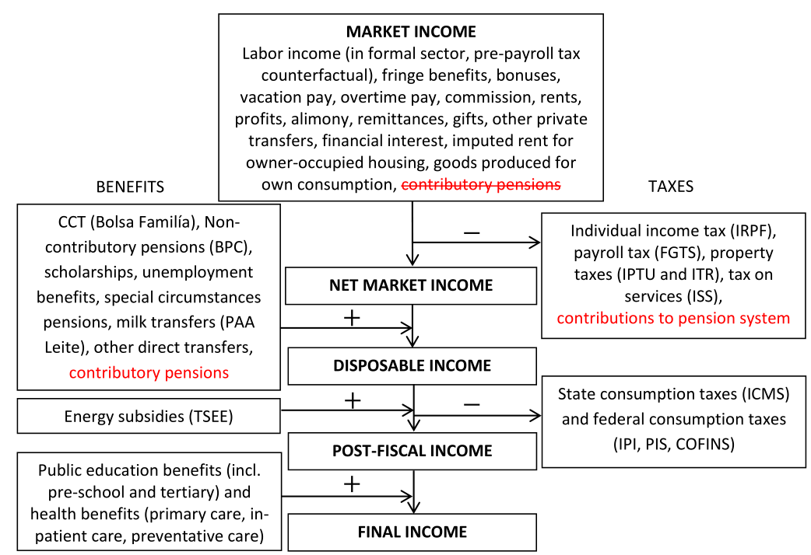
Definition of income concepts: Sensitivity analysis

Slide 5
Data
POF 2008-20009
  Labor income
  Direct taxes
  Use of public education
  Consumption
Health
  PNAD 2008
National accounts
  Revenue
  Spending

Slide 6
Direct Transfers
Bolsa Família
  Conditional cash transfer program for the poor
  Health and education conditions
  41.2 million individuals in beneficiary families in 2009 (MDS 2011)
  Average benefit per person living in a beneficiary household: $0.35 PPP per day
BPC
  Non-contributory pension for elderly poor
  3.2 million beneficiaries in 2009 (SAGI/MDS 2012)
  Average benefit per person living in a beneficiary household: $2.18 PPP per day

Slide 7
Direct Transfers (continued)
Unemployment insurance
  Require working continuously for six months prior to layoff
  8 million beneficiaries in 2009 (Ministério do Trabalho 2011)
  Average benefit per person living in a beneficiary household: $0.74 PPP per day
Special circumstances pensions
  Part of contributory system but considered non-contributory because of low or no contribution requirements and means-testing
  2.9 million beneficiaries in 2009 (INSS 2011)
  Average benefit per person living in a beneficiary household : $5.22 PPP per day

Slide 8
Direct Transfers (continued)
Milk transfers (PAA Leite)
  Largest food transfer program in Brazil
  Provides milk to low-income households with child, pregnant woman, or elderly
  In Northeast region and part of Minas Gerais state
  Eligible households receive one or two free liters of milk per day
Other direct transfers
  Minimum income programs (state and municipal)
  Government auxílios
  Basic food basket program

Slide 9
Targeted Energy Subsidies
Social Tariff on Electric Energy (TSEE)
  Price subsidy for low income households with total energy consumption below 220 kilowatt hours per month
  Discount ranges from 10% to 65%
  Average benefit per person in a beneficiary household: $0.36 PPP per day

Slide 10
In-Kind Benefits
Public education
  Free at all levels including pre-school and tertiary
Public health care
  No national health insurance system
  Unified Health System (SUS) guarantees free and unlimited access to care at public health facilities
    Part of 1988 Constitution

Slide 11
Taxes
35% of GDP
Direct taxes are 45% of total, indirect 55%
High exemption threshold and large informal sector → less than 10% of economically active pay individual income tax
Many indirect taxes
  ICMS, IPI, PIS, COFINS, …
  “Cascading effect”

Slide 12
Methodology: Direct Taxes
Direct identification method except FGTS (payroll taxes)
FGTS: simulation method
  Lack formal sector variable; assumed all workers who made other contributions on their labor income also paid FGTS
  Since paid by employer, created pre-FGTS counterfactual labor income assuming burden of tax borne fully by labor

Slide 13
Methodology: Direct Transfers
Direct identification from survey
Bolsa Família
  Discrepancy between total beneficiary households in national accounts (12.1 million) and survey (7.3)
  Use propensity score matching method (Souza, Osório, and Soares 2011) to impute benefits to very similar households who did not report receiving benefits
Milk transfers (PAA Leite)
  Assumed milk consumed with the form of purchase reported as “donation” by households in eligible states came from the program

Slide 14
Methodology: Energy Subsidies
Lack data on consumption in kilowatt hours (kWh) which determines program eligibility
Have (post-tax) energy consumption in R$/month
Collect data on (pre-tax) prices for all Brazilian energy companies and within each state, average across companies in that state
Combine with tax code for electricity in that state and with subsidy rates to determine consumption in kWh
Calculate benefit
  Spending for household’s consumption in kWh at market rates minus actual spending

Slide 15
Methodology: Indirect Taxes
ICMS and IPI
  Group consumption goods into nine categories
  Apply effective tax rates for these categories calculated by Nogueira et al. (2011)
    Uses input-output matrix
    Accounts for evasion
PIS and COFINS
  Apply effective tax rates by decile calculated by Rezende and Afonso (2010)

Slide 16
Methodology: Health Benefits
Alternate survey (PNAD 2008 health supplement)
Group types of health services reported in PNAD into 3 aggregate categories
  Primary care
  In-patient care
  Preventative care
From administrative data, calculate average per-visit spending by state and by type of care
Impute this benefit to individuals in that state who received that type of care from a public facility

Slide 17
Results
Market income is very unequal in Brazil
  Market Income Gini = 0.58
Absolute inequality reduction is impressive by Latin American (but not EU/US/OECD) standards
Nevertheless, spending is high and effectiveness is low

Slide 18
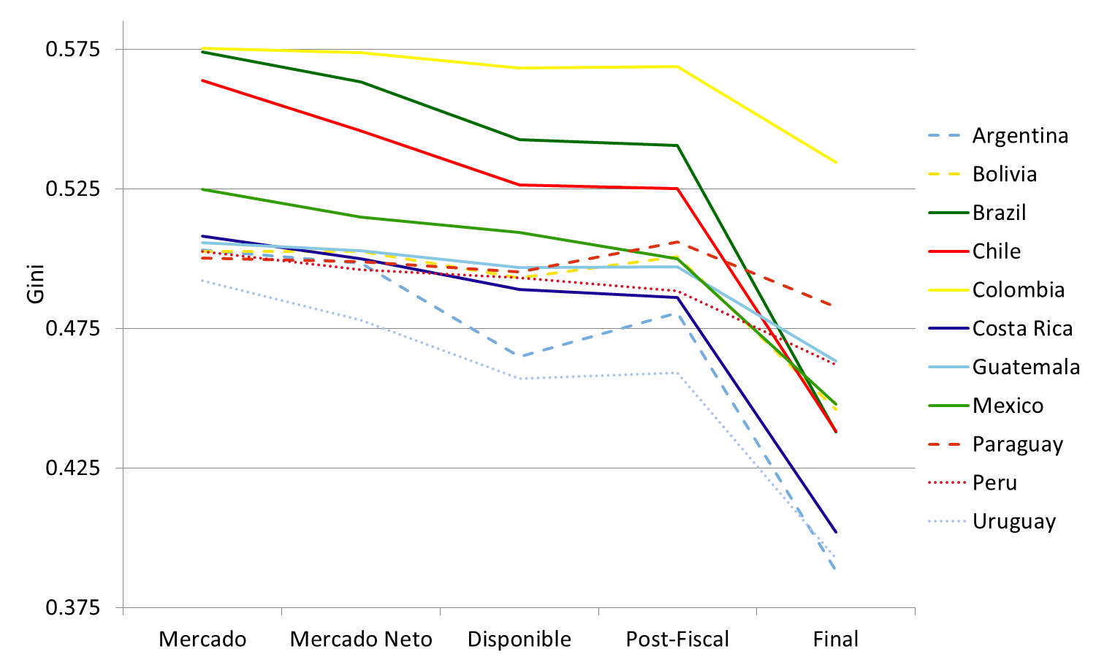
Results

Slide 19
Results
Most progressive programs (Bolsa Família, BPC, milk transfers) are small
  In terms of budget share (each <0.6% of GDP)
  And in terms of average benefit per beneficiary
Indirect taxes offset the poverty-reducing benefits of direct transfers and indirect subsidies
  Post-fiscal income poverty is higher than market income poverty for some poverty lines

Slide 20
Future work (in progress)
Urban x rural inequality
Racial/Ethnic inequality

